Slide 1
Deep Learning for Protein Classification
By Aarohi Chopra
Based on: Protein Family Classification with Neural Networks

Slide 2
Contents
Brief Background, introduction, why we care? | Proteomics
Embeddings | Family
SVM | Dataset
Neural Networks | Results
GRU | Future
LSTM? | Questions
You can visit this page for my notes https://docs.google.com/document/d/130JtG5lVGhnKk_ozJXrYRrJh7h4O7wEbo6jP-y3XS9g/edit?usp=sharing

Slide 3
Brief Background
Notes:
Pull up the paper and

Slide 4
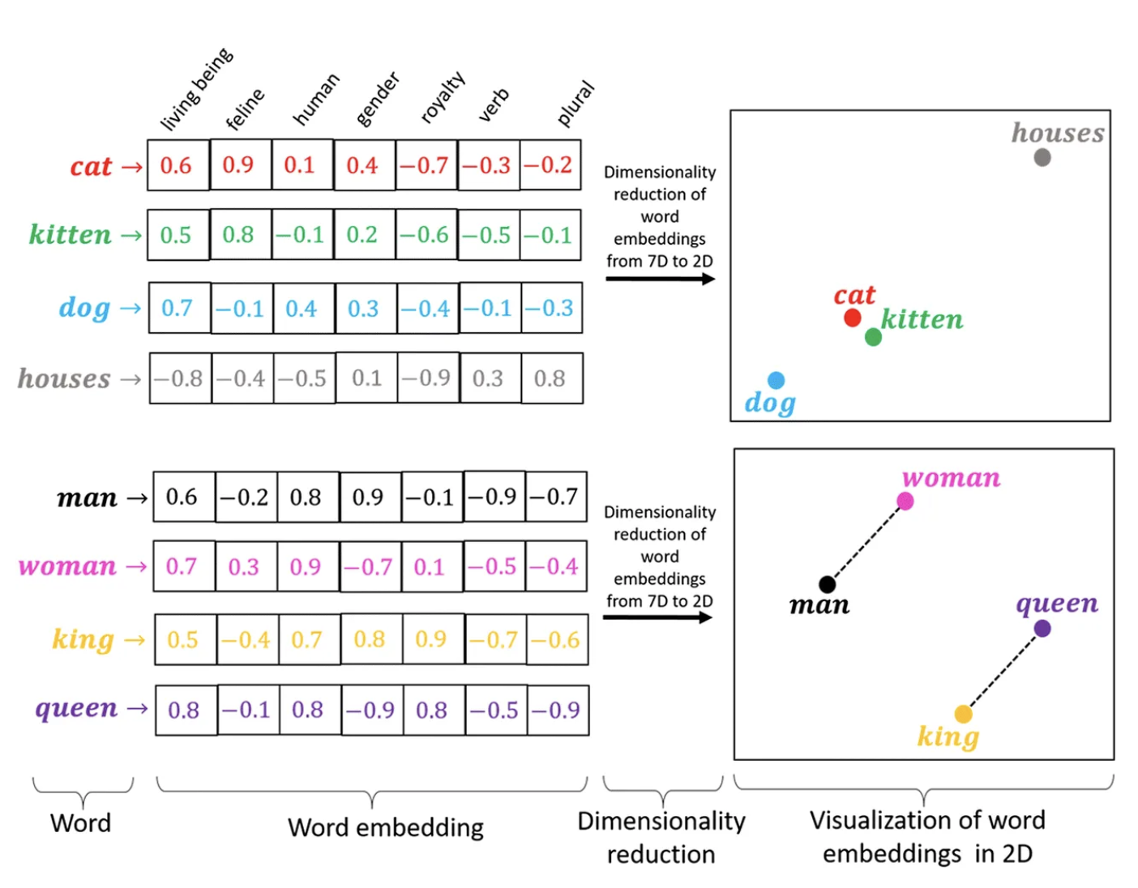
EMBEDDINGS
Word2Vec Vs GloVe

Slide 5
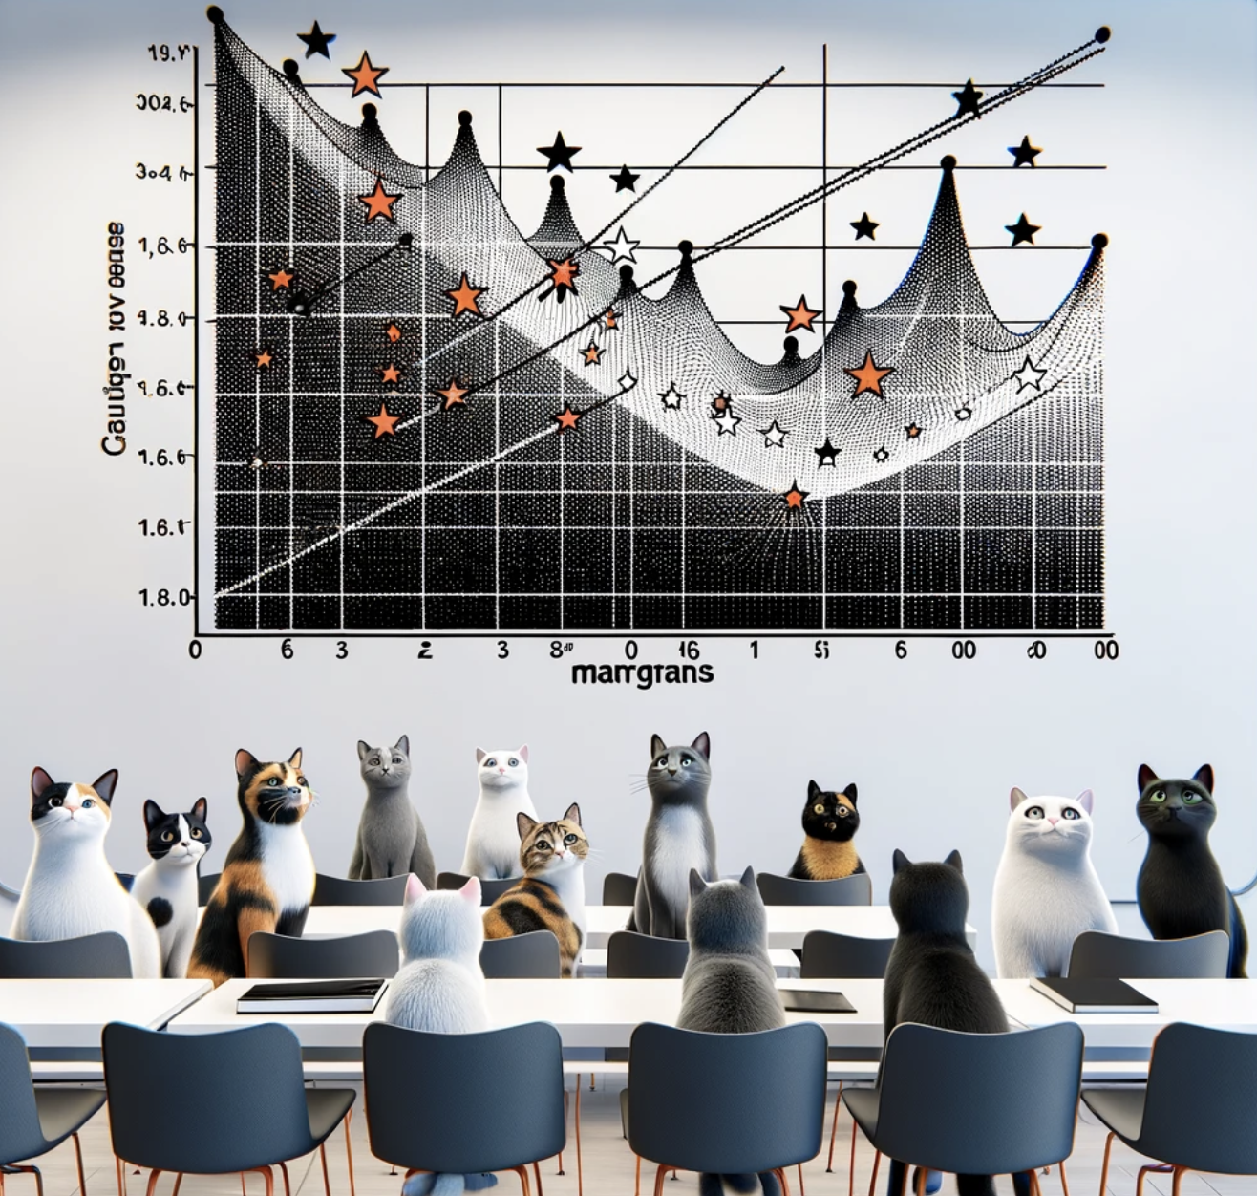

SVM: the base classifier
The general idea: find a hyperplane in n dimensional space that classifies data points, Along with having maximal margins
Support vectors?
What if data is nonlinear? Use kernel function to map data to higher dim where it is separable

Slide 6
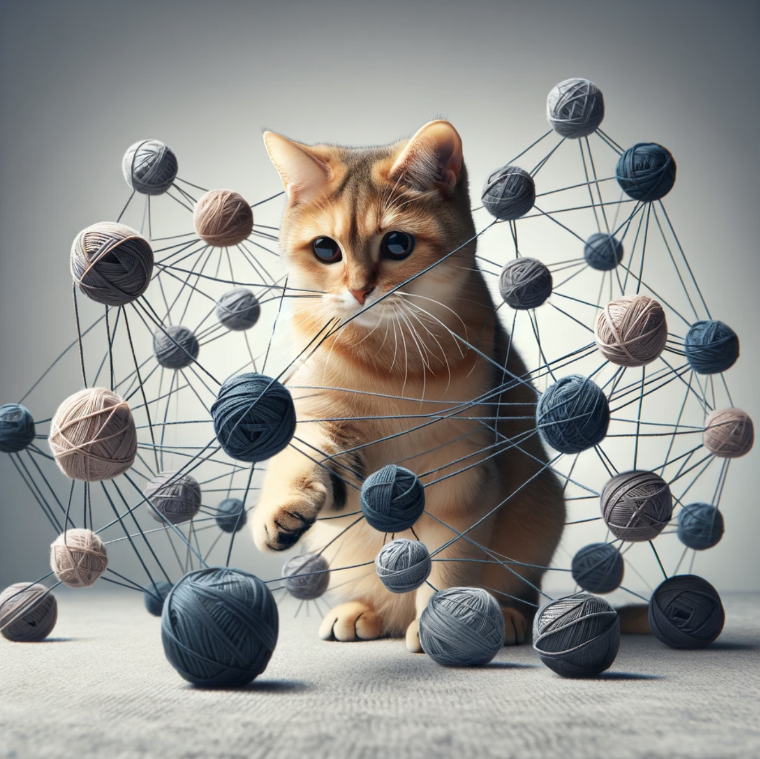
Neural Networks:

Slide 7
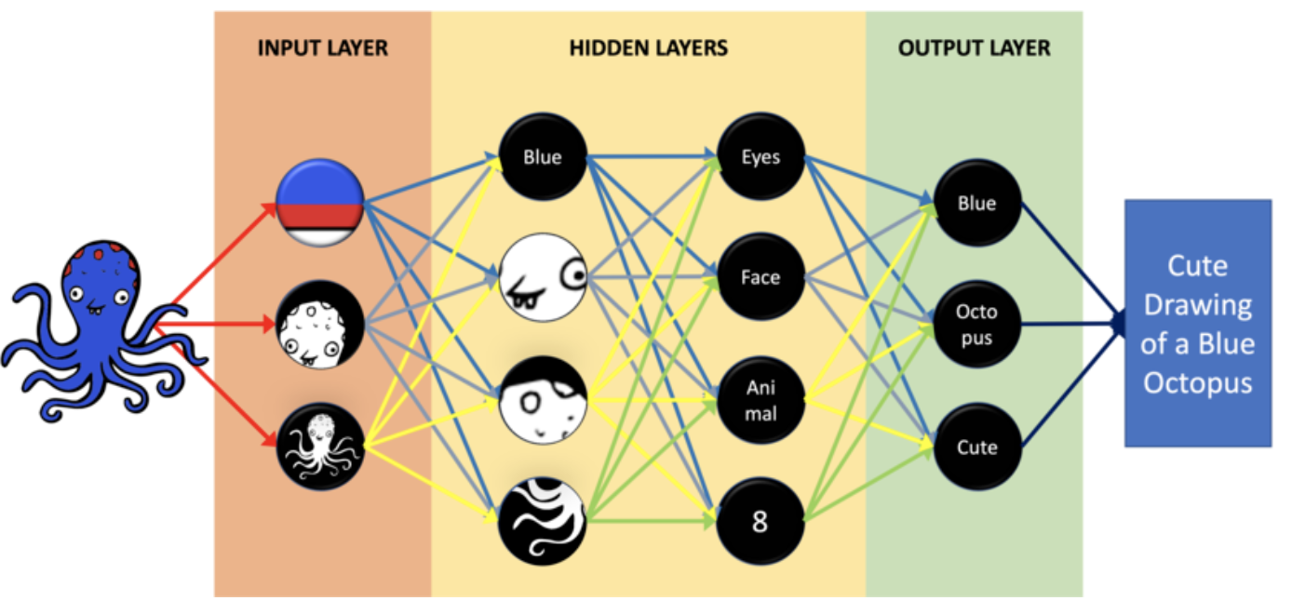
NN:
Basic Idea:
Artificial neural networks are composed of layers of node
A node represents neuron in the brain
The first layer is the input layer, followed by hidden layers finally the output layer
Each node in the neural net performs some sort of calculation, which is passed on to other nodes deeper in the network

Slide 8
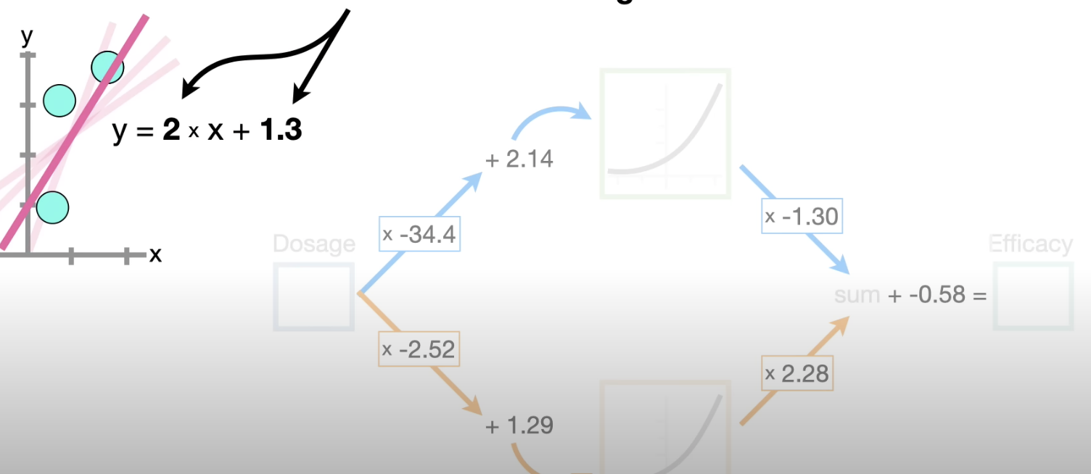
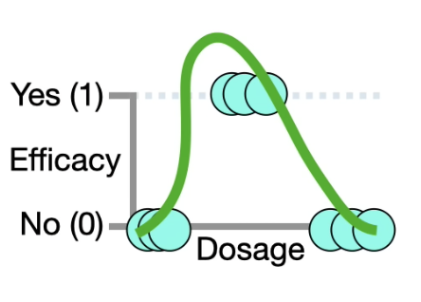
A BIT MORE DETAIL:
Neural network can fit the green swiggle!!!!
Parameters estimates are analogous to the slope and intercept value that we solve when we fit a straight line to the data
We use activation functions along with parameters which are eventually added to make the green swiggle
The magic is in adjusting the weights.
Notes:
Citation: Statquest

Slide 9
GRUs
RNNS
Memory REtention
Challenges Vanishing gradient exploding gradient
Gates
Decide whether information should be passed along
What should be continued to remember
Types of gates:
Reset Gate: Determines how to combine the new input with the previous memory.
Update Gate: Decides how much of the past information needs to be passed along to the future.
Notes:
The writer does mention any more details about how they selected nodes, layers or other hyperparameters for the model
Activation function is softmax
We drastically
improved our models by maxpooling over the entire sequence of hidden states and our final models
concatenated the maxpool and final hidden state. With the maxpooled output, we could overfit
smaller datasets easily and on the full dataset our models were able to reach validation F1 scores
above 0.9 within the first 7 epochs.

Slide 10
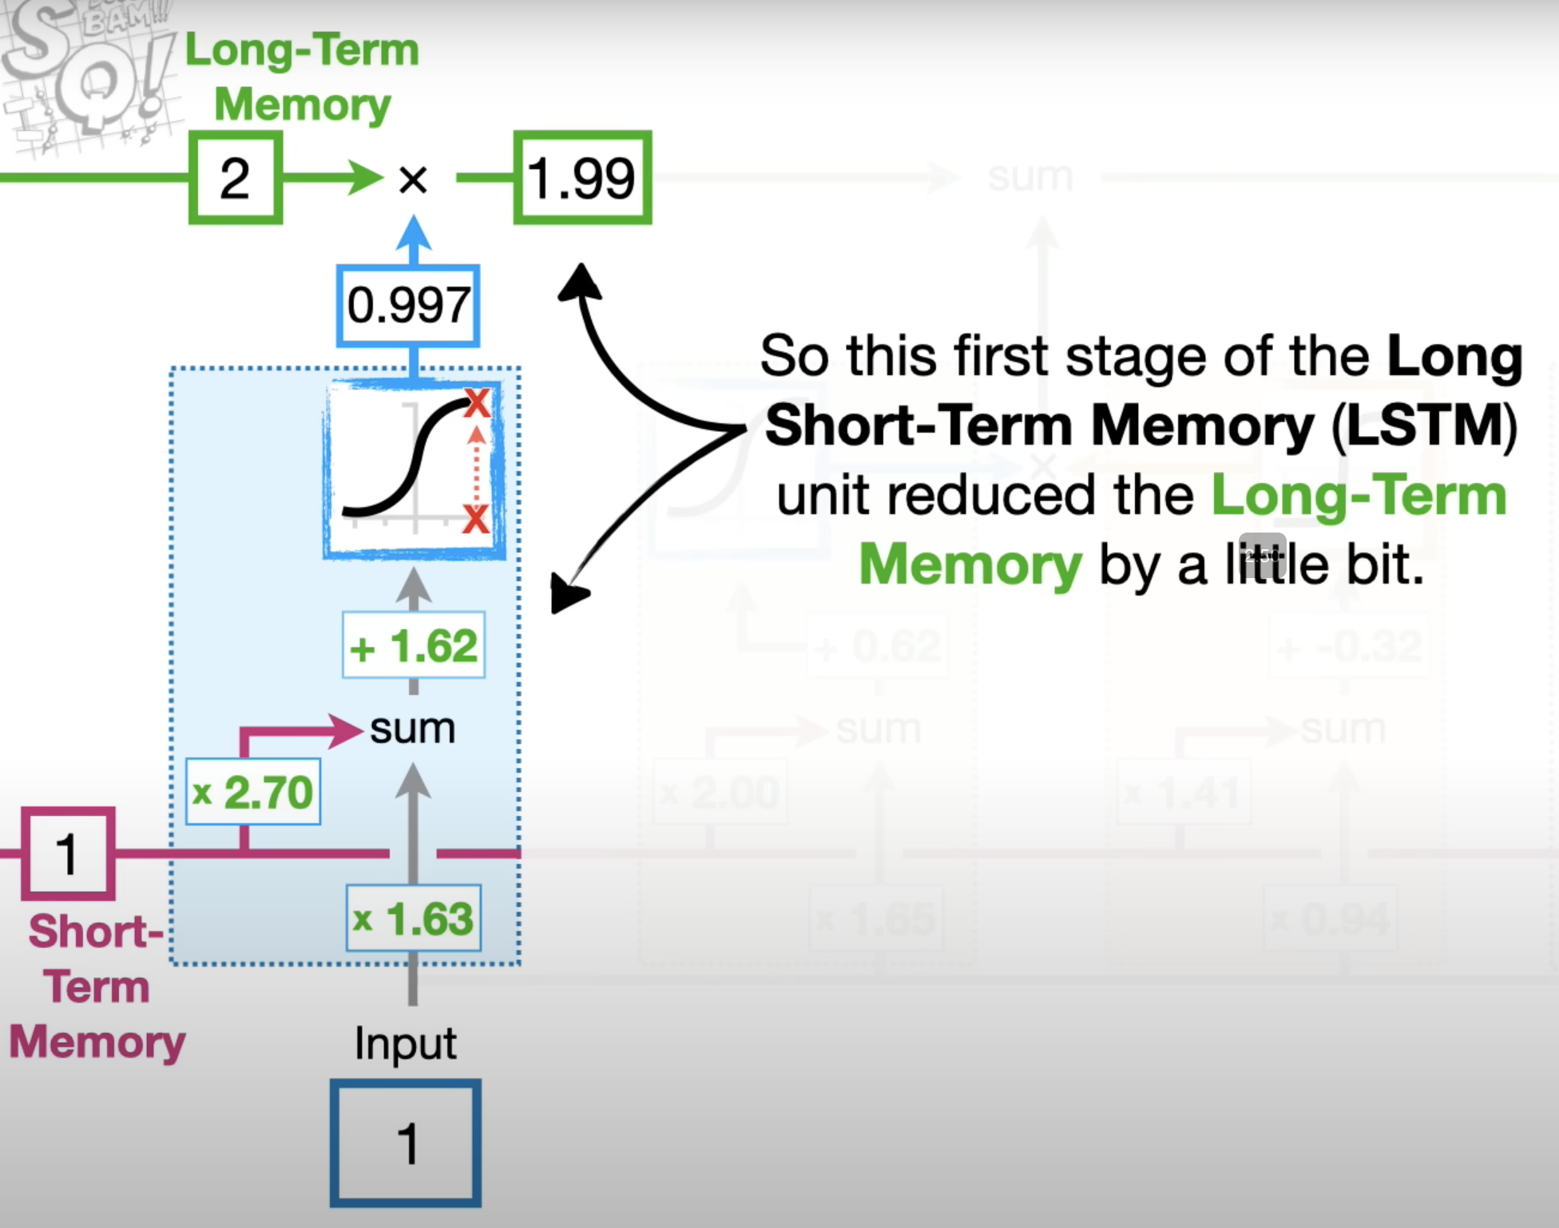
LSTMs
HAndling the same 2 problems that we faced earlier with rnns
MAIN idea ??
Note: It uses sigmoid activation function
How do we avoid the issues?
achieved near perfect accuracy on the training set,
Decreased the hidden state size as a way to generalize the model further.
attempted to decrease the dropout probability instead, which showed only a slight improvement.

Slide 11
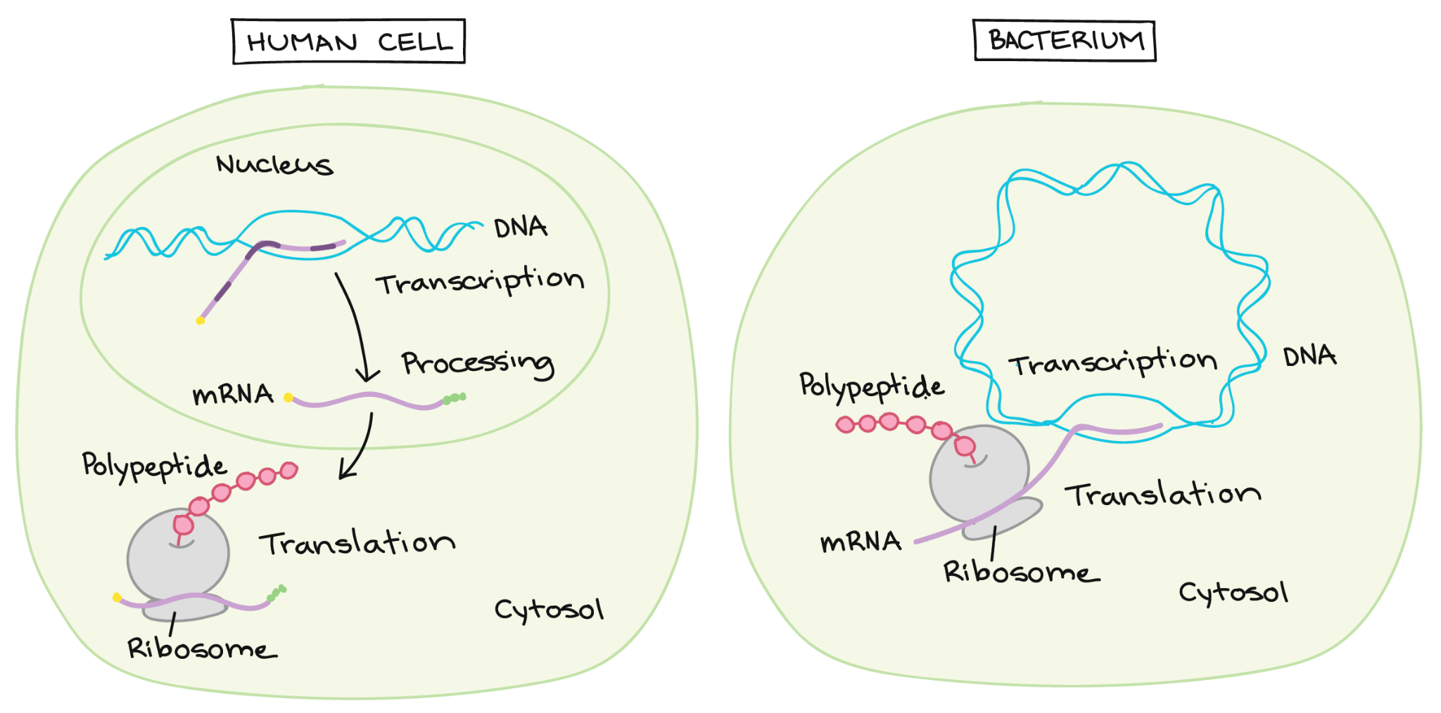
Journey to Proteomics: Decoding genes to protein families

Slide 12
Quick Recap:
Journey to Proteomics, decoding genes to protein families
DNA:
Information template
Functional polypeptide chain
duplication
Promoter region
transcription
RNA:
RNA Polymerase
Unwinding
Addition of complementary bases along with URACIL(T->U)
REGULATORY RNA
Transfer rna
Ribosome binding site
Preface and outro(5’ UTR 3’UTR)
Creating of mature rna
ProtEIN:
Translation
Elongation
Termination
Protein folding
Post translational modification
Proteomics: beyond translation

Slide 13
Few terms
Promoter Region
RNA polymerase
pre/primary RNA
Regulatory RNA
Transfer RNA
Anticodon
Ribosome binding site
Poly A tail
5’ UTR
3’UTR
Chaperone proteins

Slide 14
Family and domain of proteins
families
Structure
Evolution
Classification

Slide 15
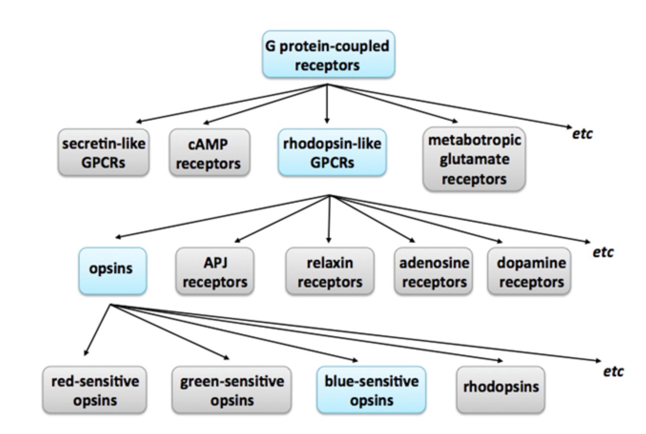
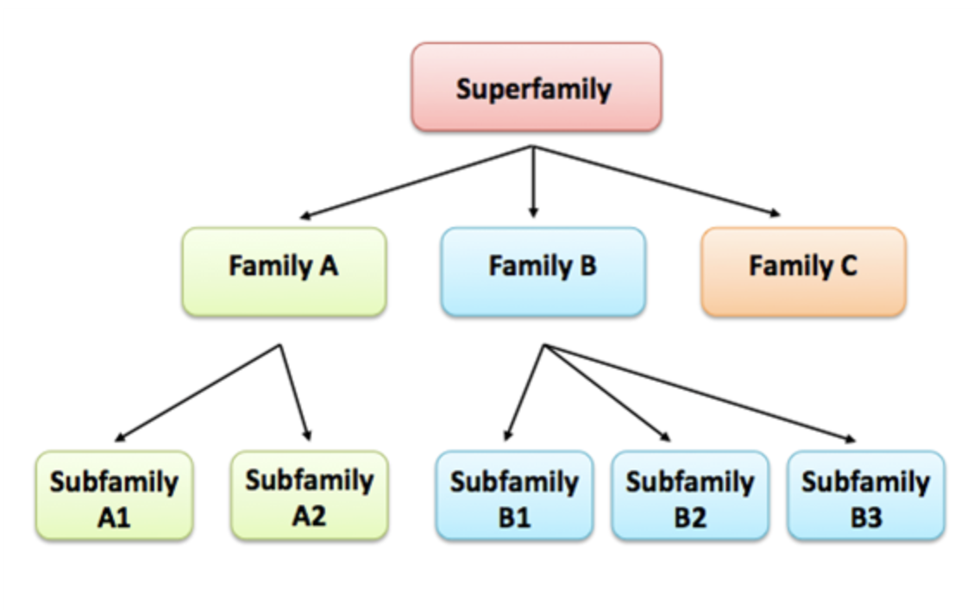

Slide 16
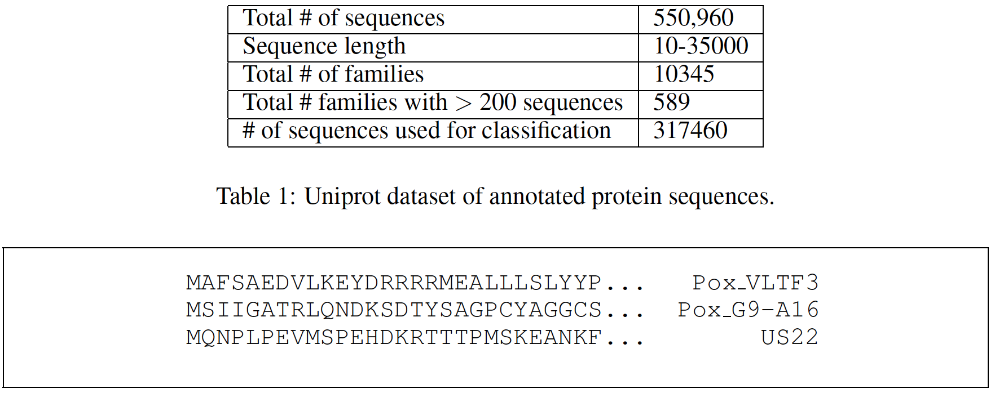
Dataset
Database: UniProt
Organism: felis catus
Only sequences more than 200
Downloaded them
Annotated them with family name using the family field(https://www.uniprot.org/help/query-fields) in the database
Notes:
Pull up the dataset and show a few of the families

Slide 17
Awesome words

Slide 18
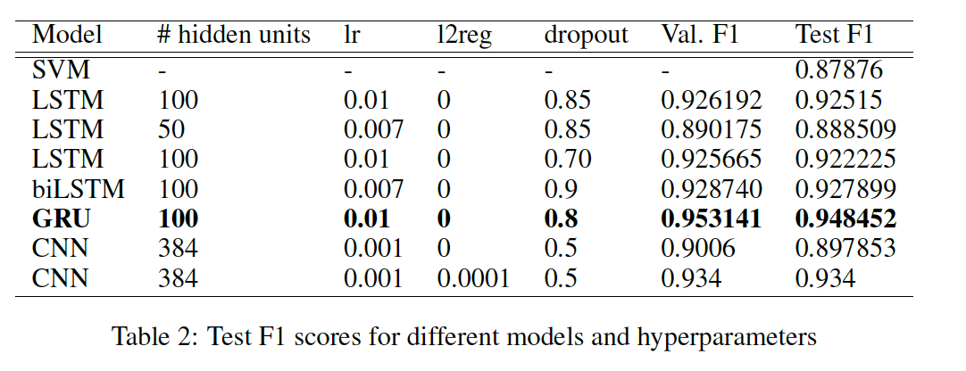
RESULTS:

Slide 19
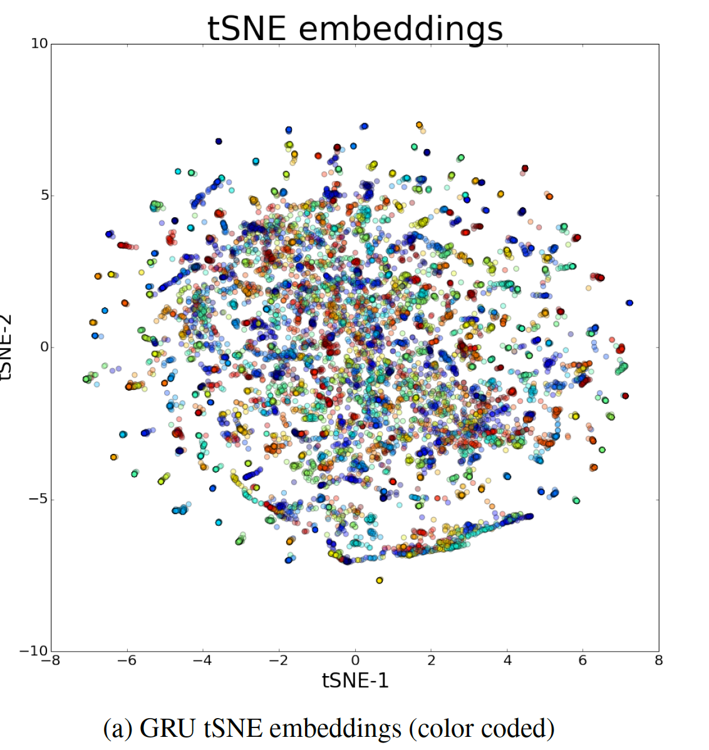
What is TSNE embeddings?
CONCLUSION:
SImilar protein embeddings should have been grouped together but we don’t see anY pattern here
Notes:
What is tSNE embeddings?

Slide 20
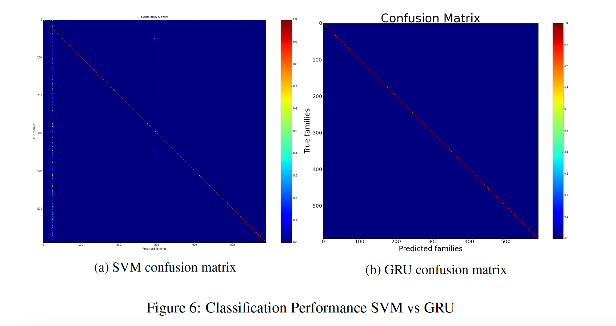

Slide 21
FUTURE RESEARCH:
Grus performed 7% higher than svms, why?
SVMs trained many single class classifier and the multiclass proteins being more complex performed well with a nn architecture
2. Experimenting with different lengths of n-gram used to train the glove embeddings can be interesting
3. The representations did not take the biological/semantic meaning into account, further investigation on that aspect is required

Slide 22
Thanks!

